Slide 1
Using online resources
Campaigns & Elections Magazine
Art of Political Campaigning Conference
June 18, 2012
#AOPC12

Slide 2
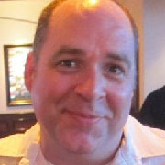


Julie Barko Germany julie.germany@gmail.com
@JulieG
Colin Delany
cpd@epolitics.com
@epolitics
Kurt Luidhart
kurt@prospergroupcorp.com
@Kurtluidhart

Slide 3
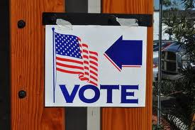
Finding voters online

Slide 4
Where do we find the voters?
Depends on who they are…
Swing?
Base?
Opponents?

Slide 5
Why?
Why are we finding them?
Recruiting?
Persuasion?
Turnout?

Slide 6
Rule #1
Go where the (right) voters are!
(wherever that is)

Slide 7
First steps
Recruiting
Incremental process (list-building takes time)
Begin as soon as tech in place (CRM)
Google ads
Targeted Facebook buys
Content (display) ads
Optimize your website

Slide 8
Expanding the reach
Recruiting, cont’d
Social channels
Blog outreach
Leverage the real world!
Let your supporters do the work
Never miss an opportunity

Slide 9
Persuasion
Can be aimed at both base and swing
Reinforce the base, convert the swing
Typically content advertising
Also can be search/social
Cookie-based targeting
Vote-suppression?

Slide 10
Turnout
Search/display
Find-your-polling-place apps
Email, email, email
Text messaging
Word of Mouth
Don’t forget early voting/absentee

Slide 11

Finding volunteers online

Slide 12
Volunteers = voters
List-building is first vital step
Voter-recruiting = volunteer-recruiting
Trick is in the conversion

Slide 13
Turning list-members into volunteers
Ladder of engagement
Easy actions, followed by more-difficult ones
Easy: “share” asks, tell-a-friend, sign a petition
Medium: virtual phone banks, show up at rally
Medium+: donate
Hard: canvass, phone bank
Harder: lead a volunteer team

Slide 14
Movin’ (them) on up
Provide opportunities
Reward/recognize
Provide MORE opportunities
Reward/recognize
Rinse/repeat…
Soylent Green is people!

Slide 15
Shhhhhhhh….
Email is king.

Slide 16
Other Tech tools
Obama Dashboard/Repub Social Victory Center
Engage
NGP/VAN
Gamification
Text messages
Change.org, Care2, Left Action
Don’t forget the bulletin board…

Slide 17

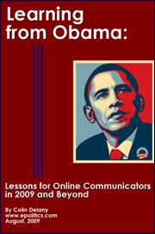
Who is this guy?
Colin Delany
Epolitics.com
202-422-4682
@epolitics
cpd@epolitics.com

Slide 18
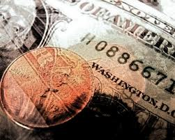
Finding donors online

Slide 19
Everyone can raise money online, but not everyone can SCALE an online fundraising operation
From ICE CUBE: Check yourself before you wreck yourself:
What am I running for?
Who am I running against?
Am I widely known for some reason?
Am I willing to “lose” money initially to go find donors?- Do I have money
Who is supporting/endorsing me?
Do I have a chance of winning?
Great commentary from Justin Hart on this: http://ihartpolitics.com/?p=44#more-44

Slide 20
Where to find them
Email
Organic
Rented
Online Ads
Search
Re-targeted
Other
Facebook
Exchanged
Twitter
Earned Media
Targeted Display

Slide 21
Where to go: Email
Opt-in: website sign-ups, Change.org/ CARE2 (for Dems)
Appending: Less profitable and risky
Exchange: 1 to 1 exchanges with candidates (but don’t send your list away!)
Rented: Newsmax, Townhall, Human Events, Ex-candidates (Newt and others), National Review, Washington Times, Glenn Beck, me
  Dems?:
Make sure you are talking to an experienced person

Slide 22
Where to go: Online Ads
Search: Everyone should do this.
Re-targeting: Yup, you should do this too
Targeted Display: Tougher for normal people- VERY good for big names
Drudge for Republicans

Slide 23
Other Stuff: Un-predictable
“Viral” videos- you don’t know what will work
Facebook is nice, but not so much for Fundraising
Twitter too
Earned Media: This is the holy grail, but you can’t manufacture it.
  A really awful online fundraising operation can make money online with a great earned media hit.

Slide 24

Thank you!
Kurt Luidhardt
The Prosper Group
317-886-4438
kurt@prospergroupcorp.com
www.prospergroupcorp.com

Slide 25

Finding activists online

Slide 26
Listening
What are people saying about you online?
Who talks about your issue in the blogosphere?
Who posts articles about you on social media?
Who is creating multimedia about your issues?

Slide 27
connecting
Offline
Online

Slide 28
targeting
Social media advertising
Outbrain
Search engines
Targeted, interactive online advertising campaigns

Slide 29
Driving action
Advocacy tools
Shareable actions and content
Follow-up
Rewards & Recognition

Slide 30
Julie Barko Germany julie.germany@gmail.com
@JulieG
Colin Delany
cpd@epolitics.com
@epolitics
Kurt Luidhart
kurt@prospergroupcorp.com
@Kurtluidhart

